Slide 1
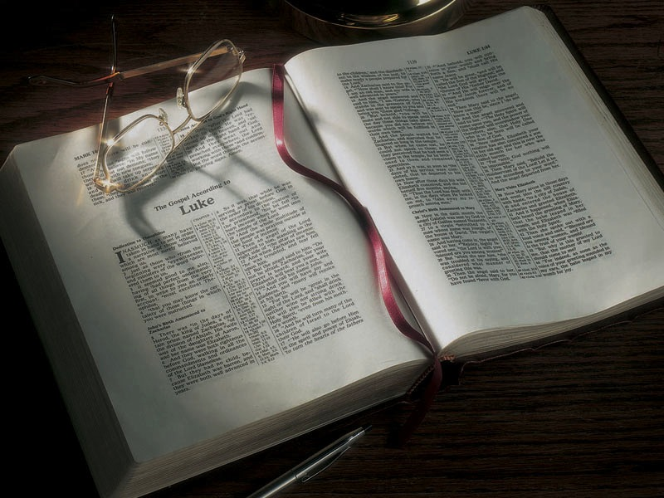

Slide 2
A Land of
Milk and Honey
(and You)

Slide 3
What is the Feast of Unleavened Bread all about?

Slide 4
What is the Feast of Unleavened Bread all about?
• Building a relationship with God.

Slide 5
What is the Feast of Unleavened Bread all about?
• Building a relationship with God.
We do that by:

Slide 6
What is the Feast of Unleavened Bread all about?
• Building a relationship with God.
We do that by:
• Removing the leaven of sin from our lives.

Slide 7
What is the Feast of Unleavened Bread all about?
• Building a relationship with God.
We do that by:
• Removing the leaven of sin from our lives.
• Putting the true Bread of Life, Jesus Christ, into our lives.

Slide 8
What is the Feast of Unleavened Bread all about?
• Building a relationship with God.
We do that by:
• Removing the leaven of sin from our lives.
• Putting the true Bread of Life, Jesus Christ, into our lives.
Do we know God, or do we know about God?

Slide 9
1 Corinthians 10:11
11 Now all these things happened to them as examples, and they were written for our admonition, upon whom the ends of the ages have come.

Slide 10
Deuteronomy 8:2-16
2 “And you shall remember that the LORD your God led you all the way these forty years in the wilderness, to humble you and test you, to know what was in your heart, whether you would keep His commandments or not.
3 “So He humbled you, allowed you to hunger, and fed you with manna which you did not know nor did your fathers know, that He might make you know that man shall not live by bread alone; but man lives by every word that proceeds from the mouth of the LORD. …

Slide 11
Deuteronomy 8:2-16
7 “For the LORD your God is bringing you into a good land, a land of brooks of water, of fountains and springs, that flow out of valleys and hills;
8 “a land of wheat and barley, of vines and fig trees and pomegranates, a land of olive oil and honey;…

Slide 12
Deuteronomy 8:2-16
11 “Beware that you do not forget the LORD your God . . .
15 “who led you through that great and terrible wilderness, in which were fiery serpents and scorpions and thirsty land where there was no water; who brought water for you out of the flinty rock;
16 “who fed you in the wilderness with manna, which your fathers did not know, that He might humble you and that He might test you, to do you good in the end”

Slide 13
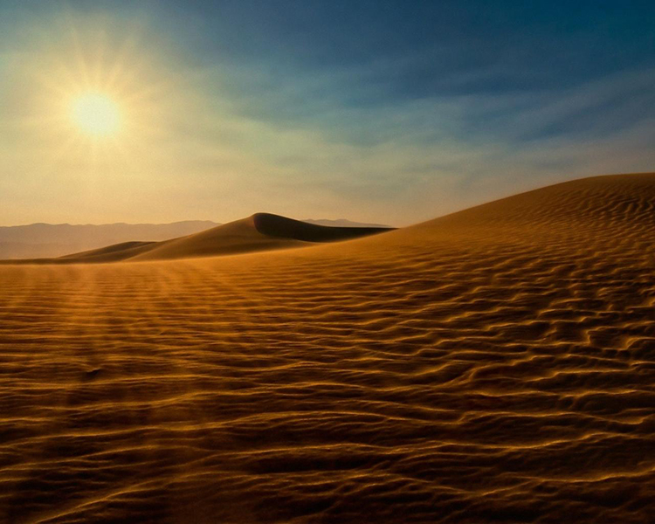

Slide 14
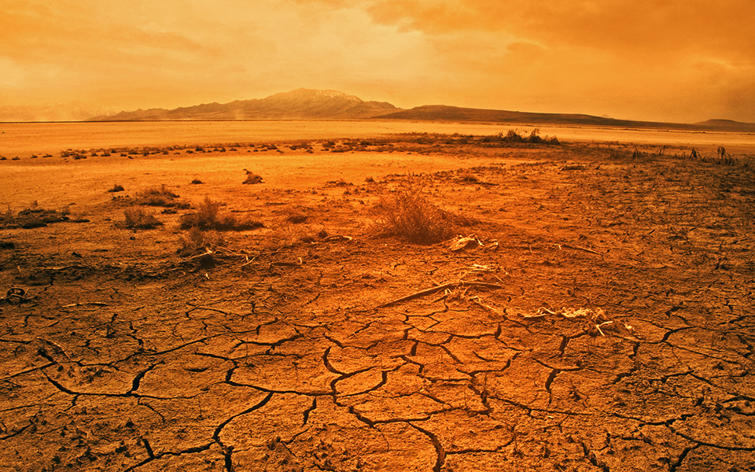

Slide 15
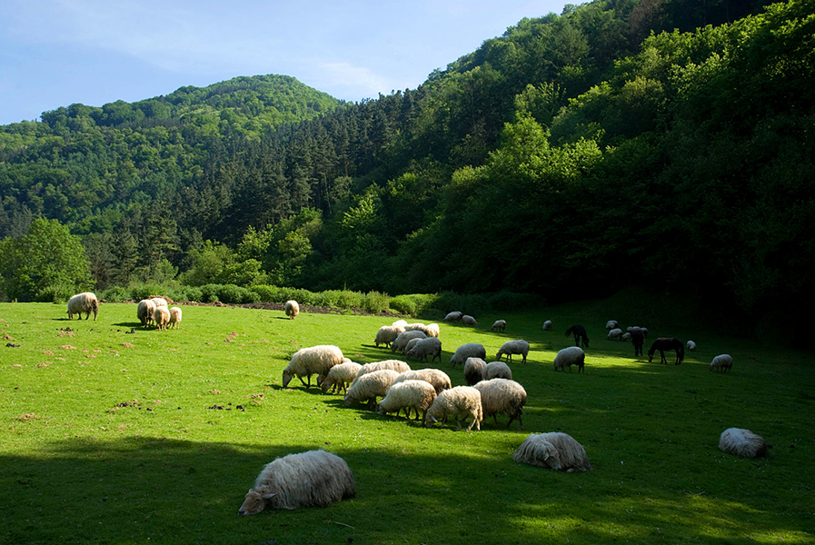

Slide 16
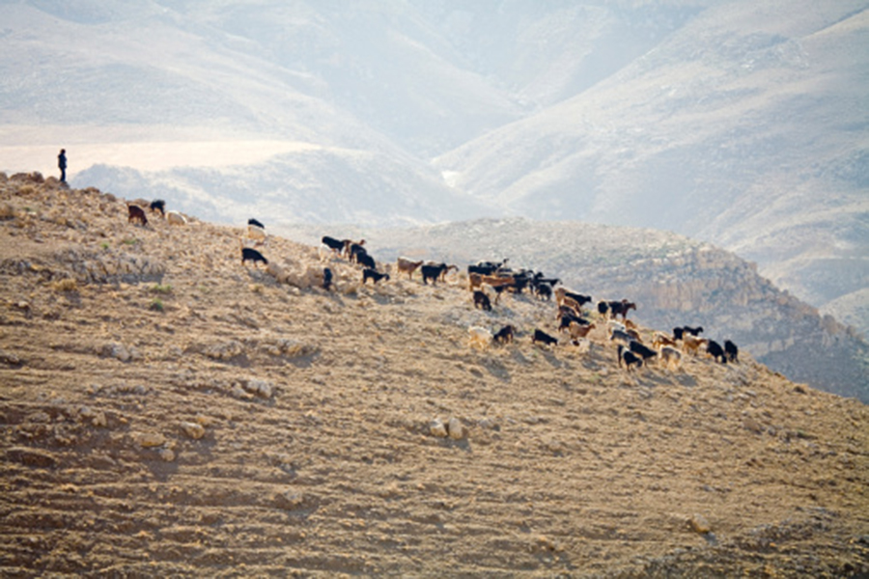

Slide 17
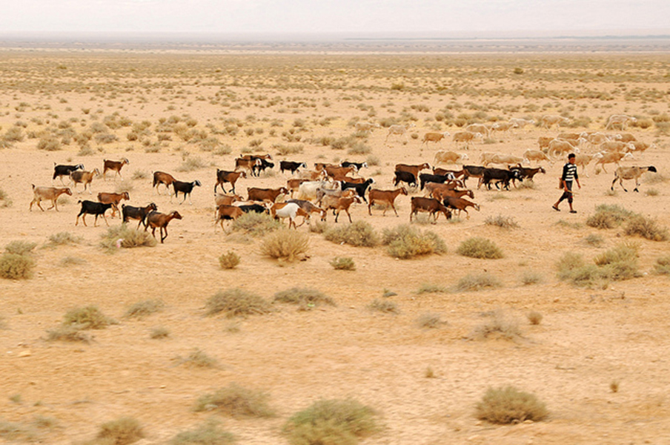

Slide 18
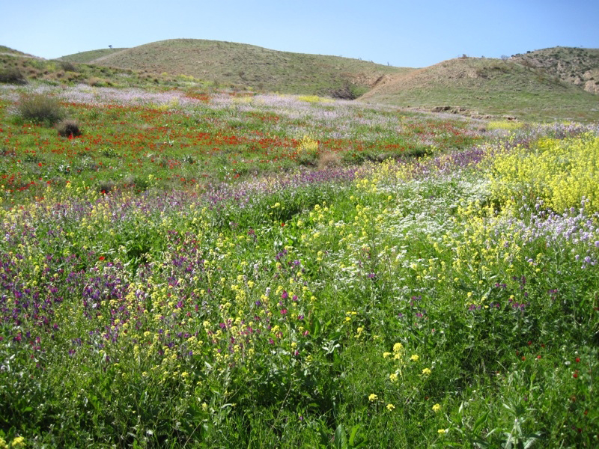

Slide 19
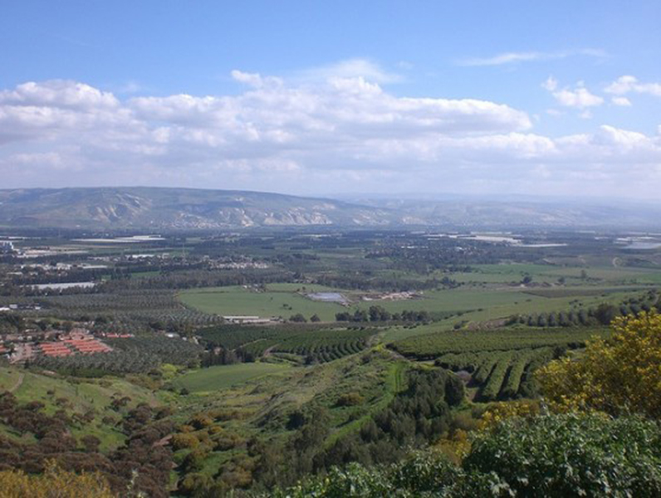

Slide 20
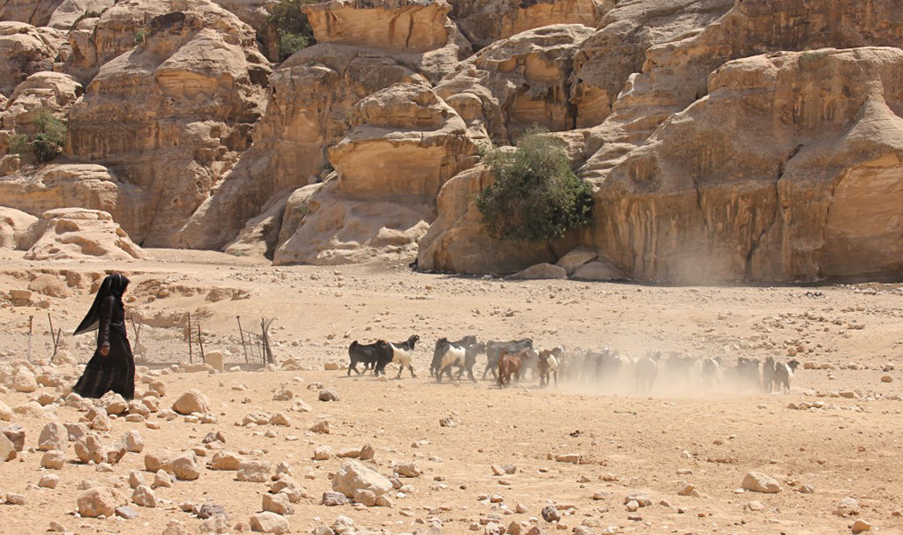

Slide 21
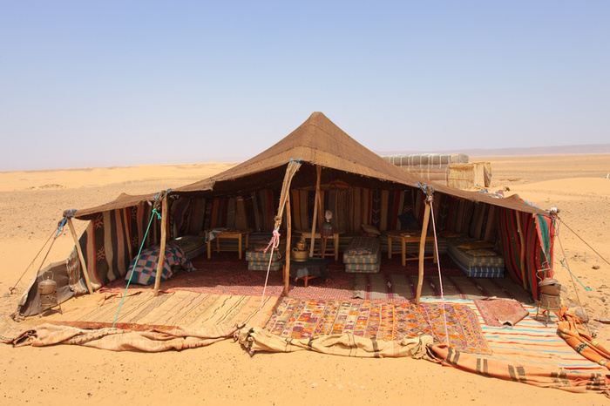

Slide 22
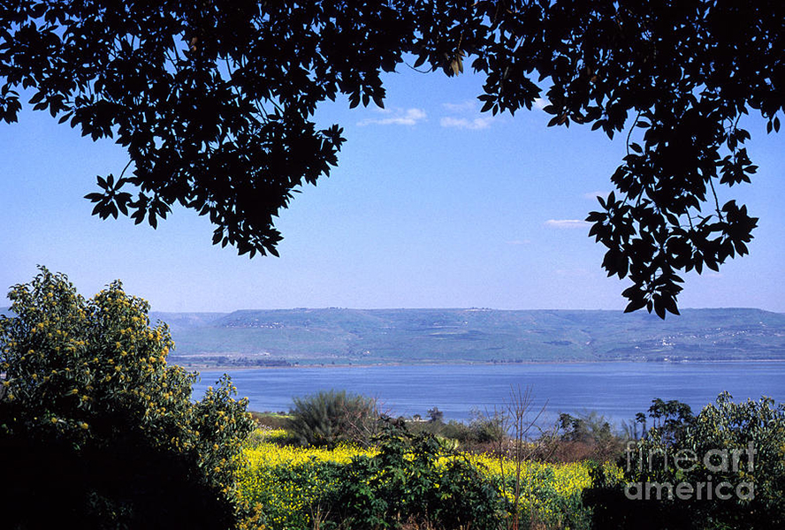

Slide 23
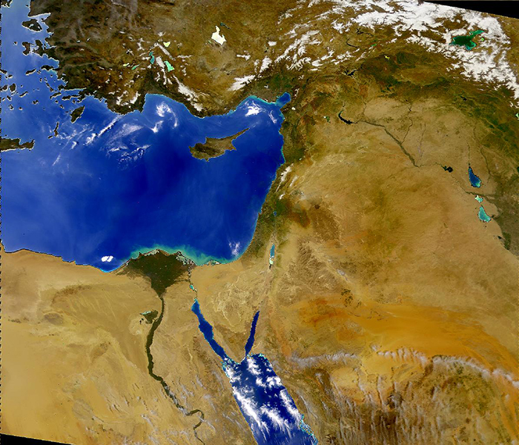

Slide 25
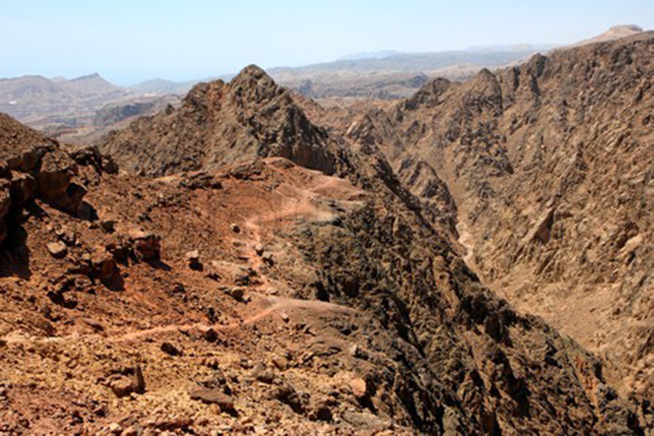

Slide 26
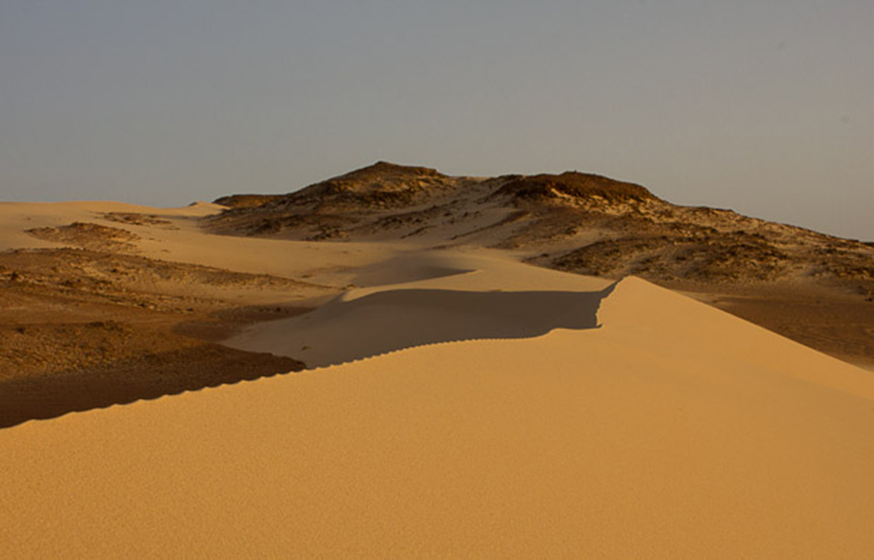

Slide 27
Lessons From Israel’s Journey
in the Desert
• It was easier to take Israel out of Egypt than it was to take Egypt out of Israel.

Slide 28
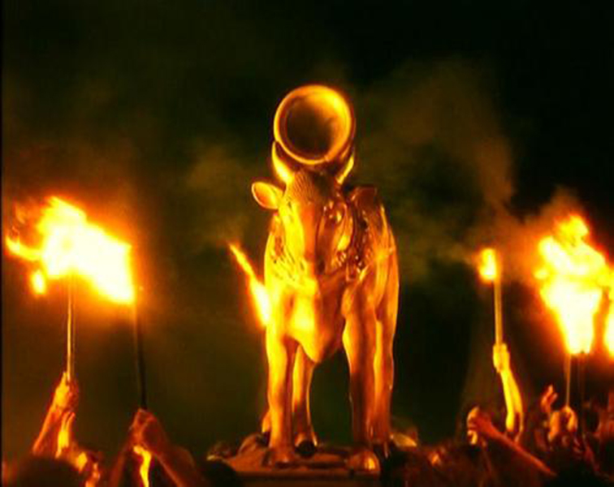

Slide 29
Numbers 14:22-
27 “How long shall I bear with this evil congregation who complain against Me? I have heard the complaints which the children of Israel make against Me. . . .
29 ‘The carcasses of you who have complained against Me shall fall in this wilderness, . . . from twenty years old and above.
30 ‘Except for Caleb the son of Jephunneh and Joshua the son of Nun, you shall by no means enter the land which I swore I would make you dwell in.

Slide 30
Numbers 14:22-
31 ‘But your little ones, whom you said would be victims, I will bring in, and they shall know the land which you have despised. . . .
33 ‘And your sons shall be shepherds in the wilderness forty years, and bear the brunt of your infidelity, until your carcasses are consumed in the wilderness.
34 ‘According to the number of the days in which you spied out the land, forty days, for each day you shall bear your guilt one year, namely forty years, and you shall know My rejection.

Slide 31
Lessons From Israel’s Journey
in the Desert
• It was easier to take Israel out of Egypt than it was to take Egypt out of Israel.

Slide 32
Lessons From Israel’s Journey
in the Desert
• It was easier to take Israel out of Egypt than it was to take Egypt out of Israel.
• Why did God choose the route that He chose for the Israelites?

Slide 34
Exodus 16:2-3
2 . . . The whole community of Israel spoke bitterly against Moses and Aaron.
3 “Oh, that we were back in Egypt,” they moaned. “It would have been better if the LORD had killed us there! At least there we had plenty to eat. But now you have brought us into this desert to starve us to death.”

Slide 35
Lessons From Israel’s Journey
in the Desert
• It was easier to take Israel out of Egypt than it was to take Egypt out of Israel.
• Why did God choose the route that He chose for the Israelites? He didn’t choose the easy way.
• The deeper they got into the desert, the greater and more common were the miracles.

Slide 36
Lessons From Israel’s Journey
in the Desert
• It was easier to take Israel out of Egypt than it was to take Egypt out of Israel.
• Why did God choose the route that He chose for the Israelites? He didn’t choose the easy way.
• The deeper they got into the desert, the greater and more common were the miracles. God had to challenge them, get them out of their comfort zone, to work with them. He does the same with us.

Slide 37
Lessons From Israel’s Journey
in the Desert
• What was the result of these things?

Slide 38
Jeremiah 2:2 (NLT)
2 This is what the LORD says: I remember how eager you were to please me as a young bride long ago, how you loved me and followed me even through the barren wilderness.

Slide 39
Lessons From Israel’s Journey
in the Desert
• What was the result of these things?

Slide 40
Lessons From Israel’s Journey
in the Desert
• What was the result of these things?
God and Israel grew to love one another in the desert.

Slide 41
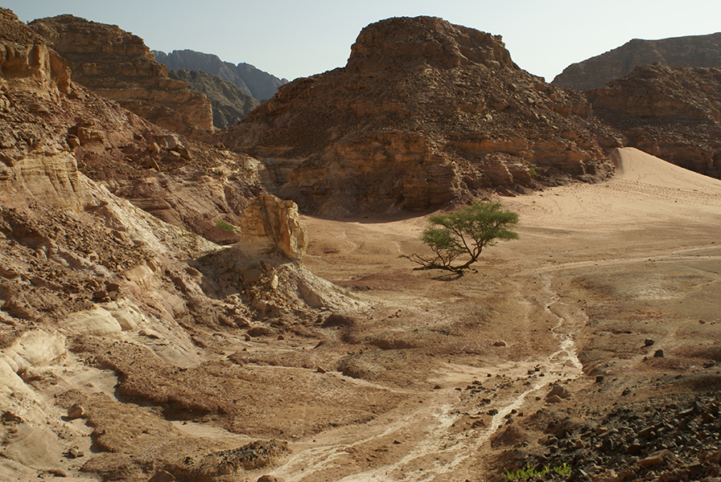

Slide 43
Psalm 34:8
8 Oh, taste and see that the LORD is good . . . !
Psalm 119:103
103 How sweet are Your words to my taste, sweeter than honey to my mouth!

Slide 44
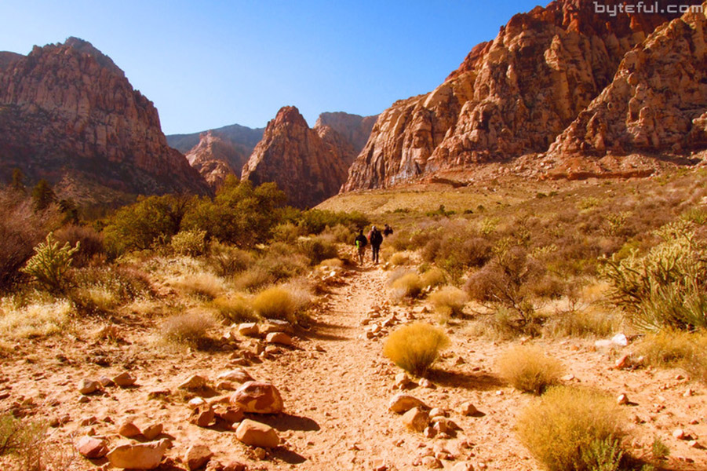

Slide 45
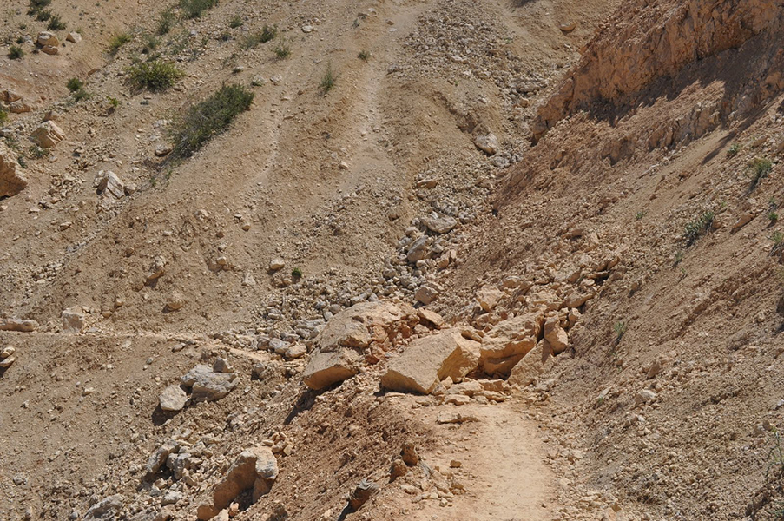

Slide 46
Psalm 81:13-16
13 “Oh, that My people would listen to Me, that Israel would walk in My ways!
. . .
16 He would have fed them also with the finest of wheat; and with honey from the rock I would have satisfied you.”

Slide 48
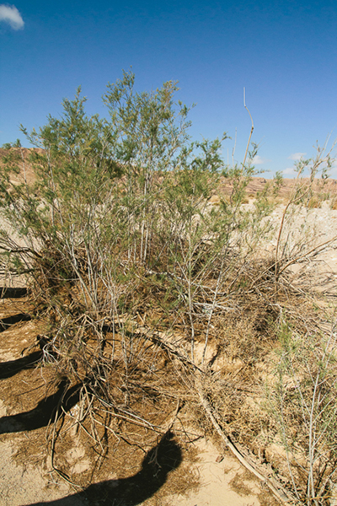

Slide 50
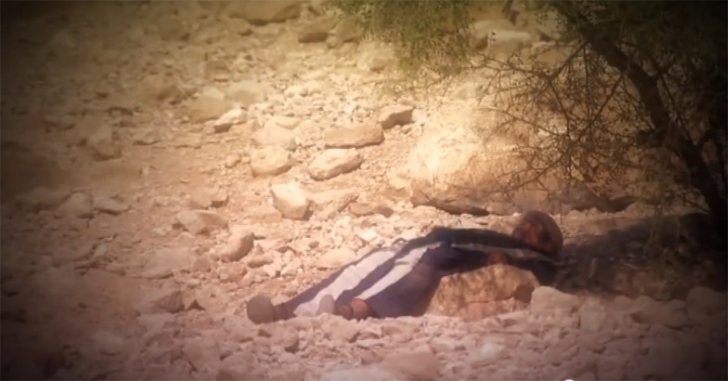

Slide 51
Psalm 121:6
6 The sun shall not strike you by day, nor the moon by night.

Slide 53
Psalm 121:6
5 The LORD is your keeper; the LORD is your shade at your right hand.
6 The sun shall not strike you by day, nor the moon by night.

Slide 55
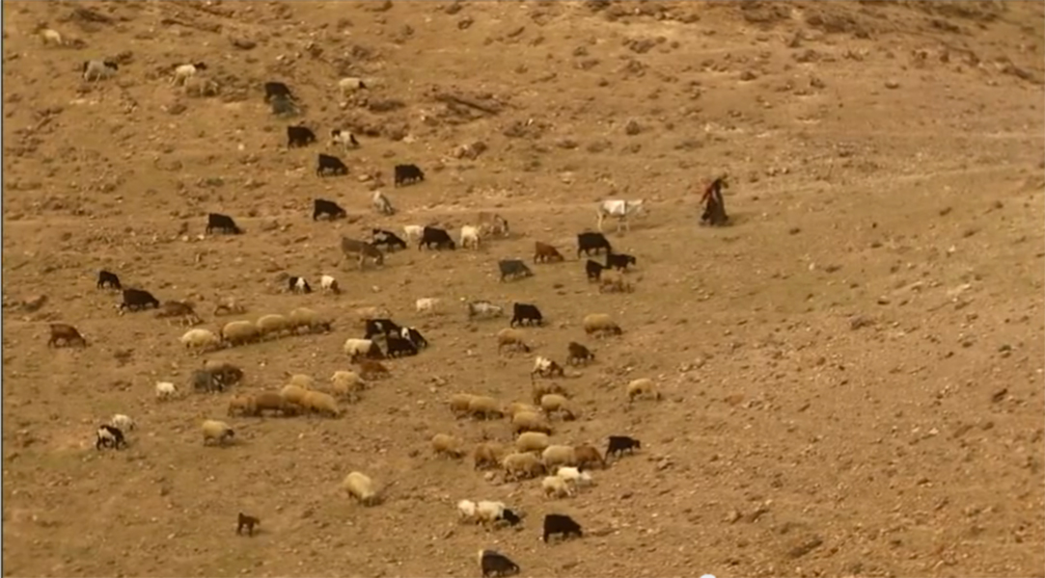

Slide 56
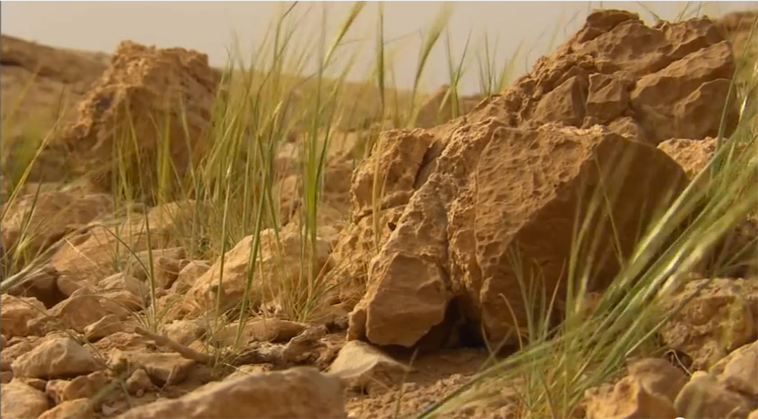

Slide 57
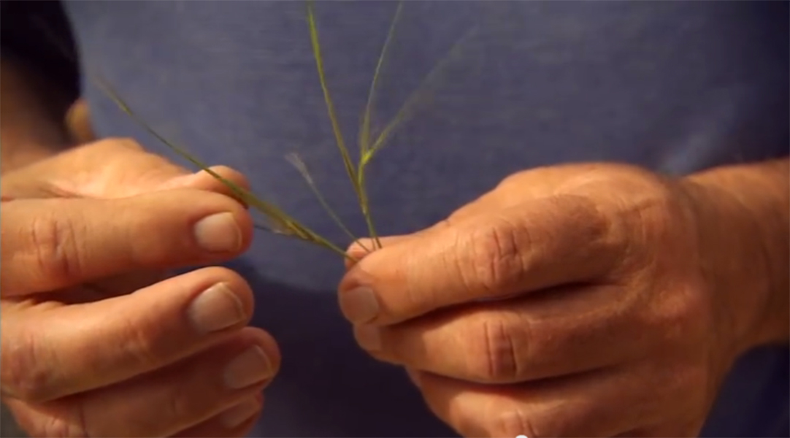

Slide 58
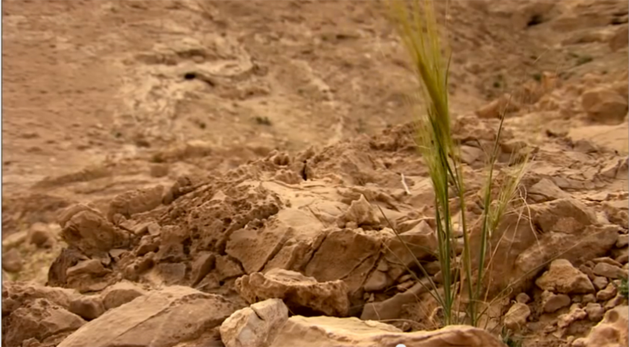

Slide 59
Psalm 23:1-2
1 The LORD is my shepherd; I shall not want.
2 He makes me to lie down in green pastures . . .

Slide 60
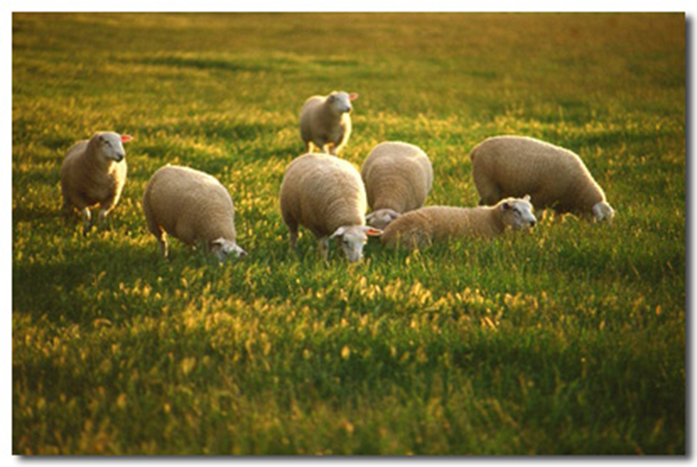

Slide 62
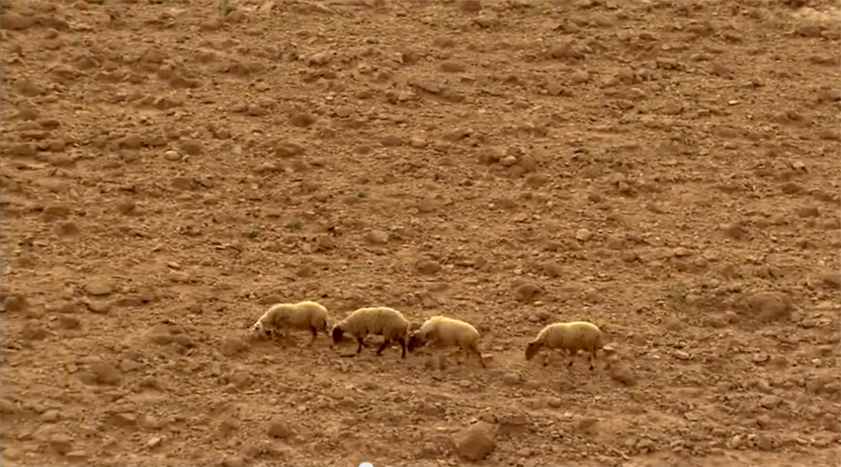

Slide 65
Deuteronomy 8:2-3
2 “And you shall remember that the LORD your God led you all the way these forty years in the wilderness, to humble you and test you, to know what was in your heart, whether you would keep His commandments or not.
3 “So He humbled you, allowed you to hunger, and fed you with manna which you did not know nor did your fathers know, that He might make you know that man shall not live by bread alone; but man lives by every word that proceeds from the mouth of the LORD.

Slide 71
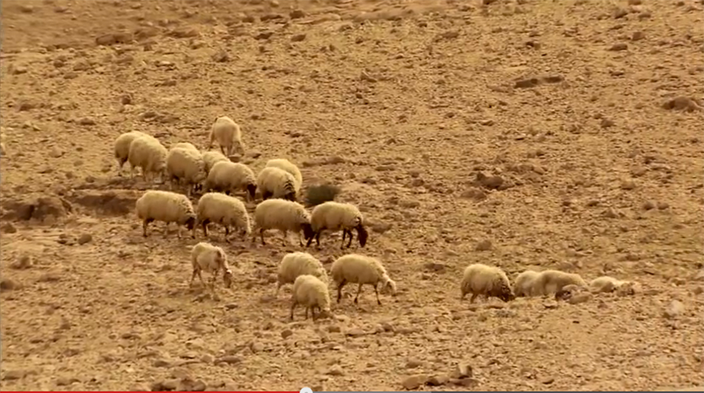

Slide 72
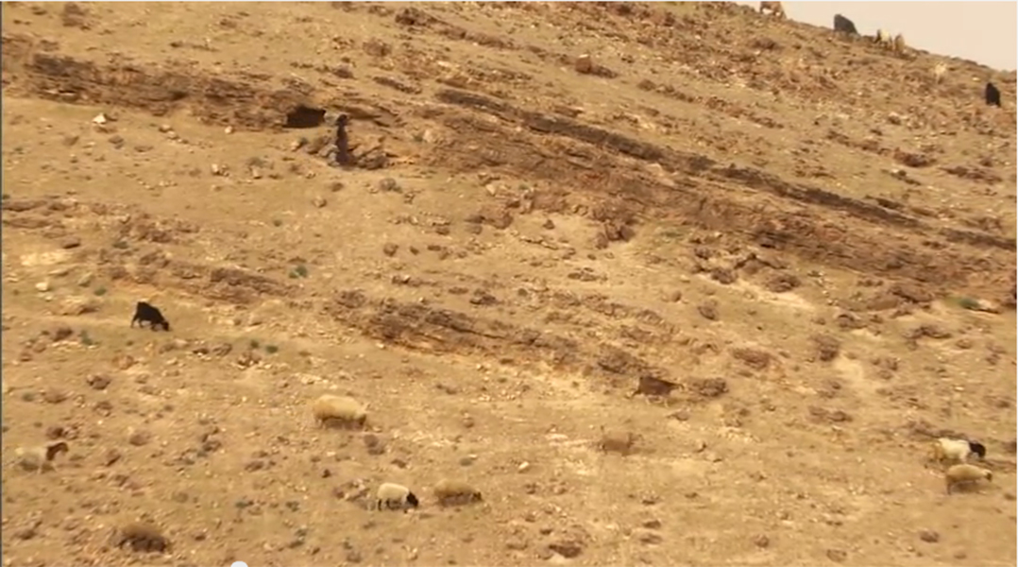

Slide 73
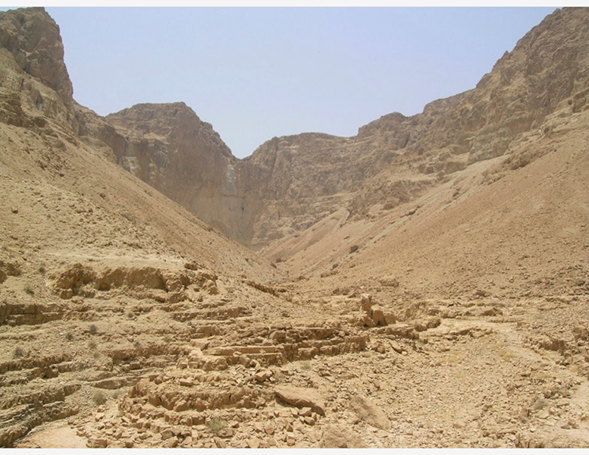

Slide 74
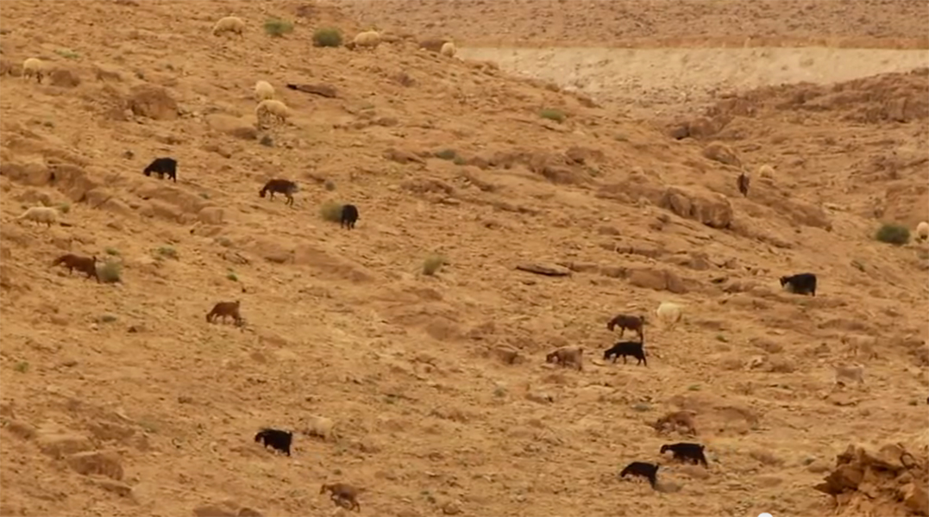

Slide 75
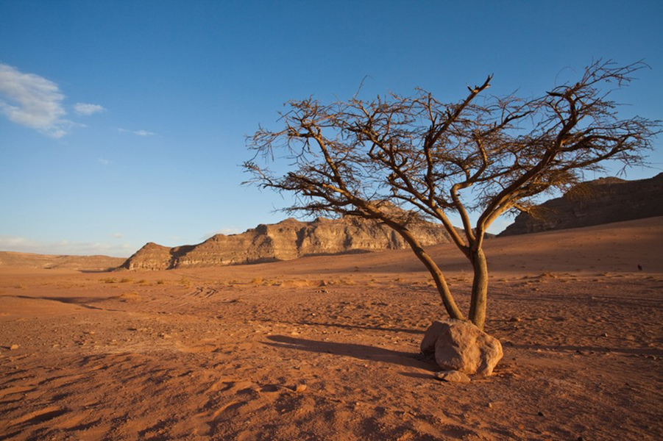

Slide 76
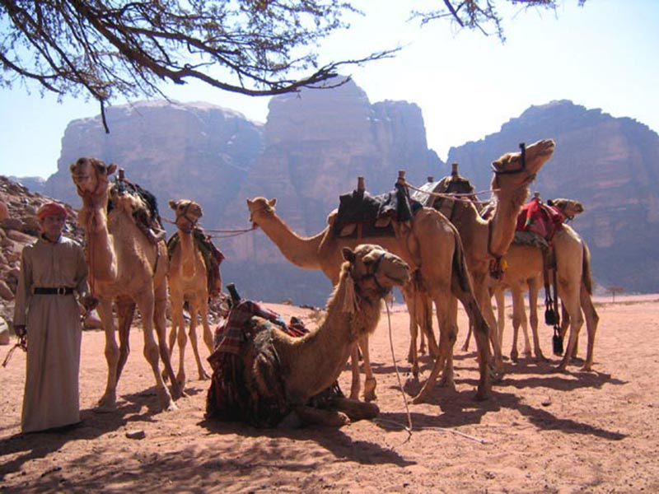

Slide 77
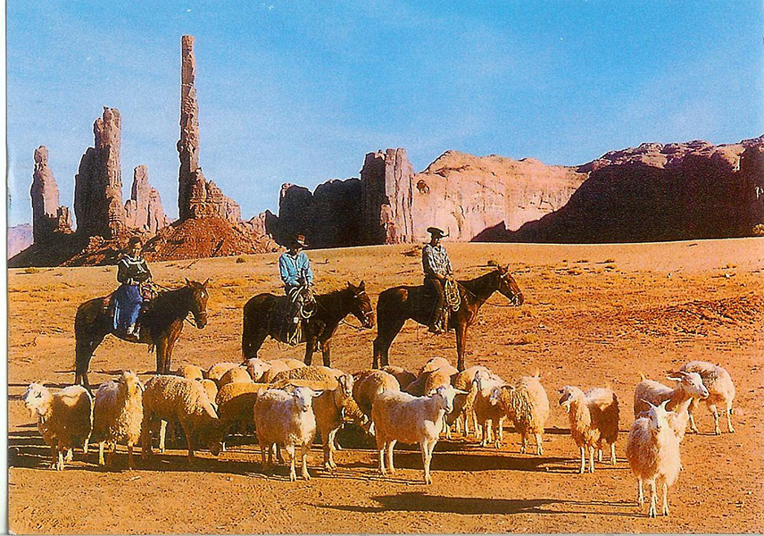

Slide 78
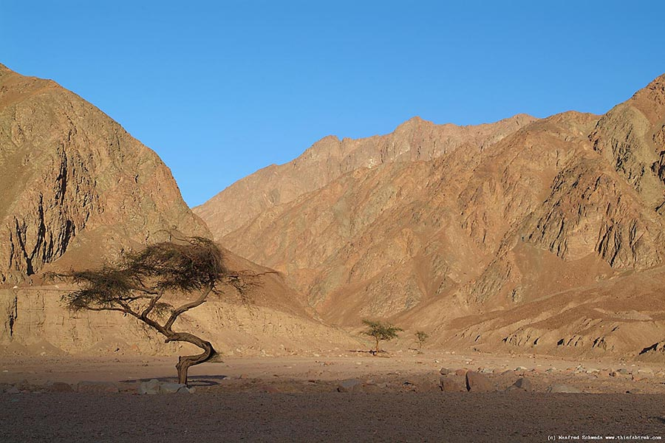

Slide 79
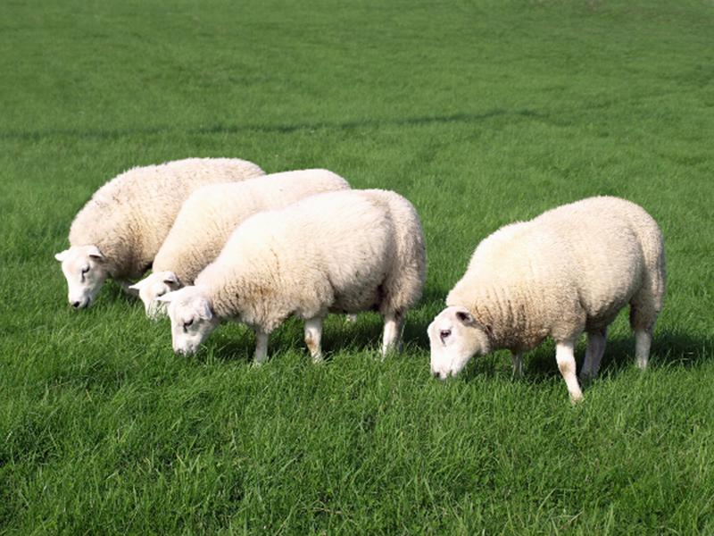

Slide 80
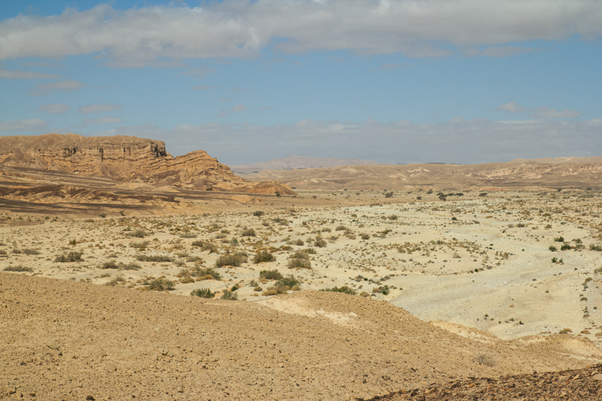

Slide 81
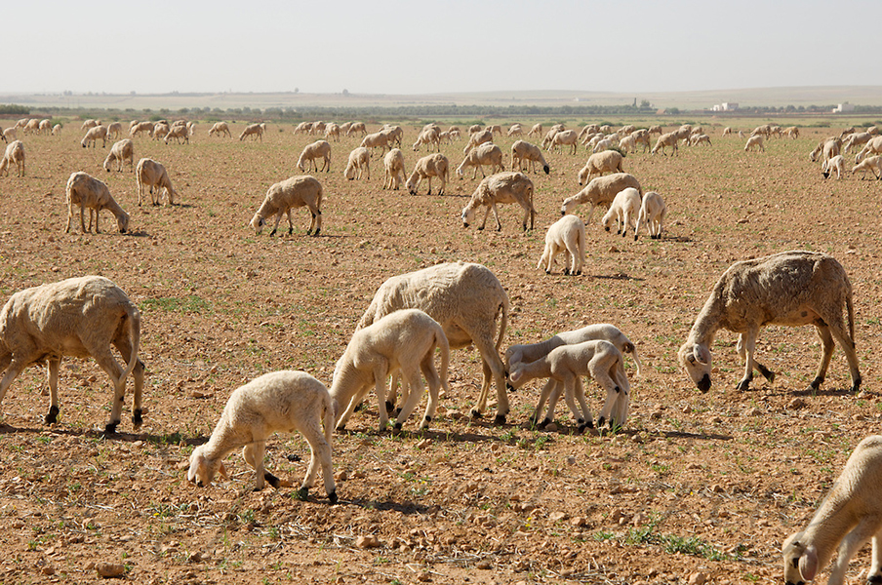

Slide 82
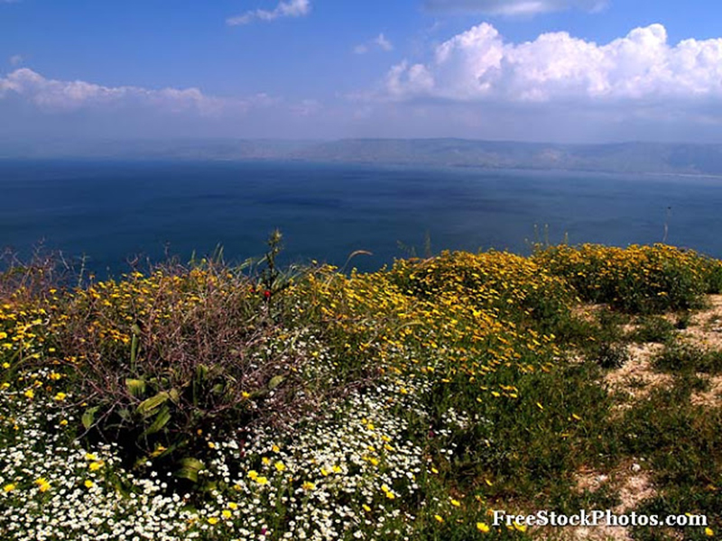

Slide 83
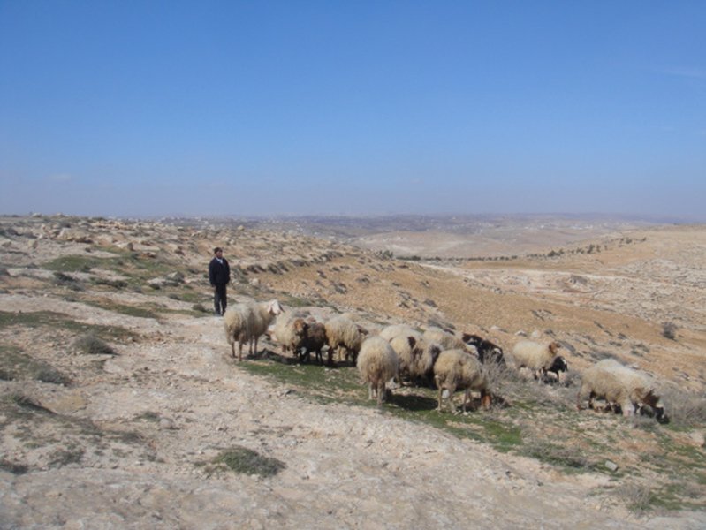

Slide 84
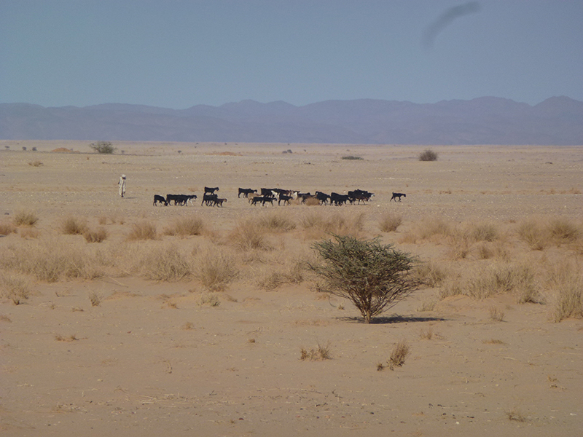

Slide 86
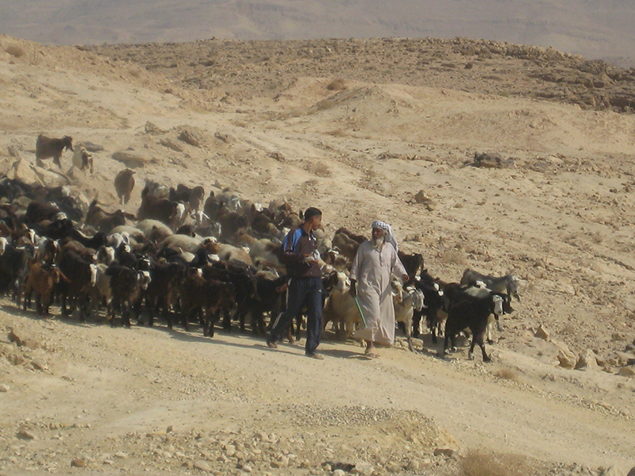

Slide 87
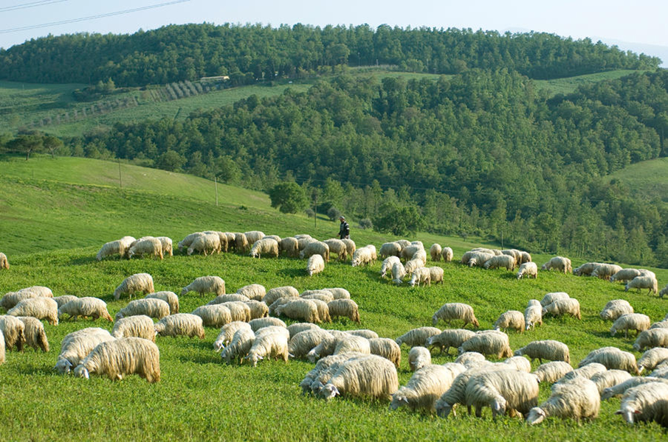

Slide 88
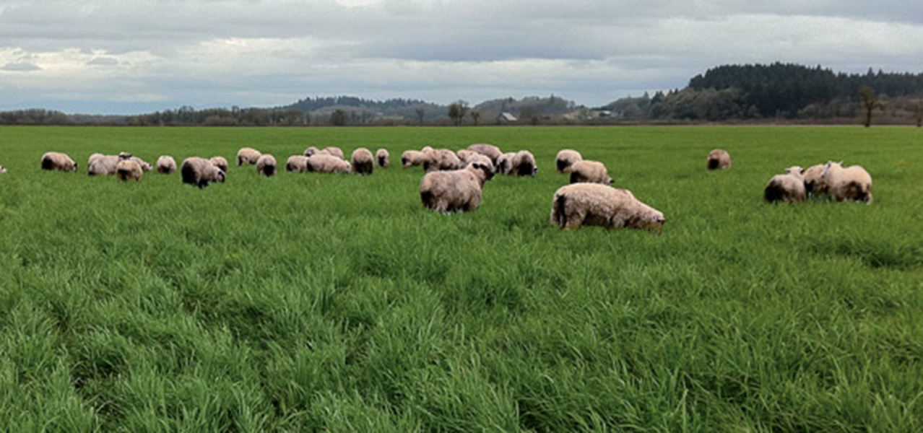

Slide 91
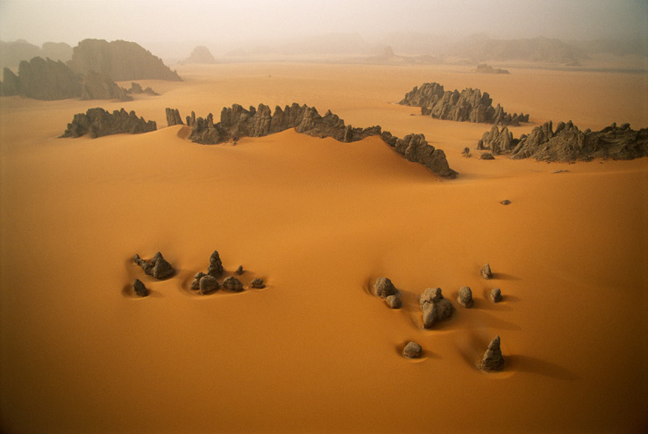

Slide 93
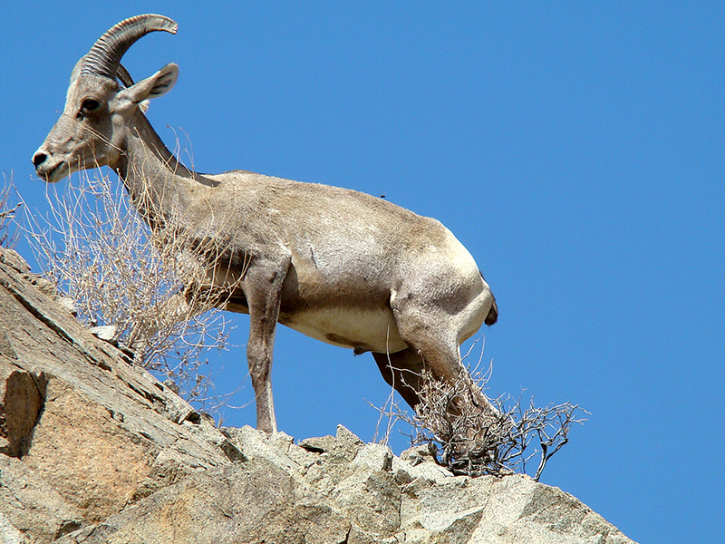

Slide 94
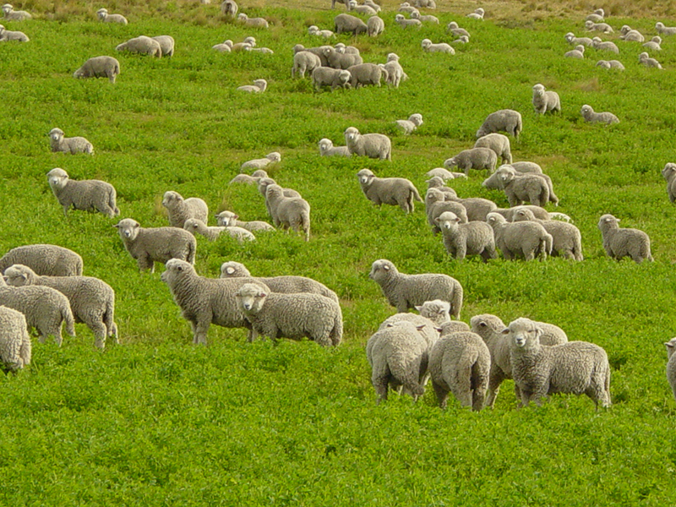

Slide 95
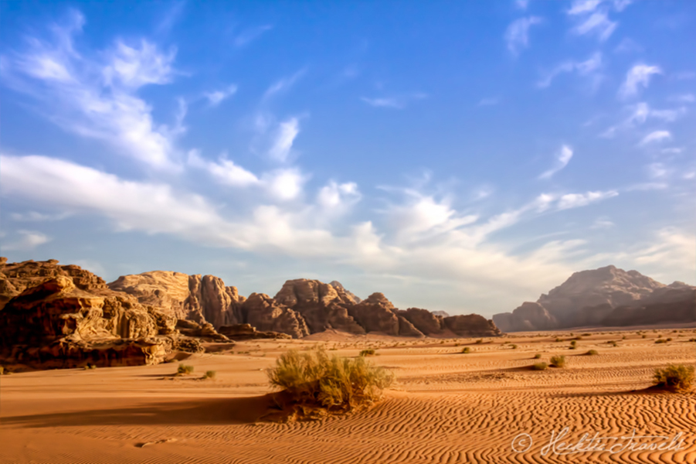

Slide 96
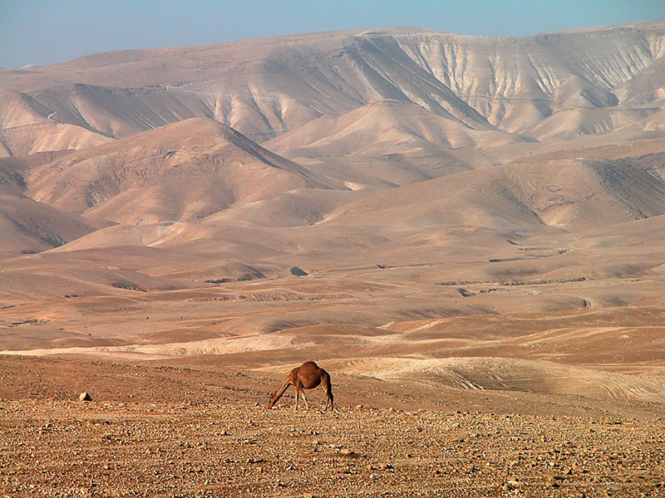

Slide 97
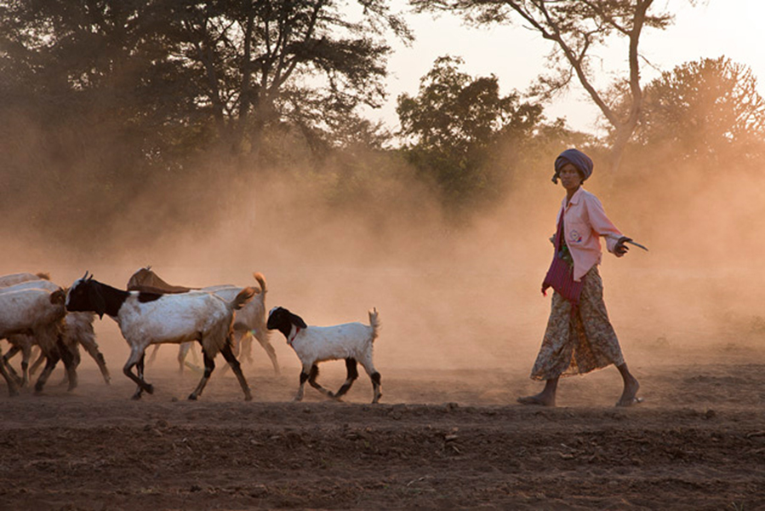

Slide 98
